Slide 1
Digital Portfolio
STUDENT NAME: P.Gowtham anandh
REGISTER NO AND NMID: 222404558/451F0333DF230739CC44D41FFD76D5CE
DEPARTMENT: bsc.software application
COLLEGE: COLLEGE/ UNIVERSITY:A.m jain college

Slide 2
PROJECT TITLE DIGITAL PORTFOLIO

Slide 3


AGENDA
Problem Statement
Project Overview
End Users
Tools and Technologies
Portfolio design and Layout
Features and Functionality
Results and Screenshots
Conclusion
Github Link
3/21/2024 Annual Review

Slide 4

PROBLEM STATEMENT 1)Building the structure 2)Giving perfect colors 3)Inserting pictures 4)Making scrolling smooth 5)Makling it responsive

Slide 5
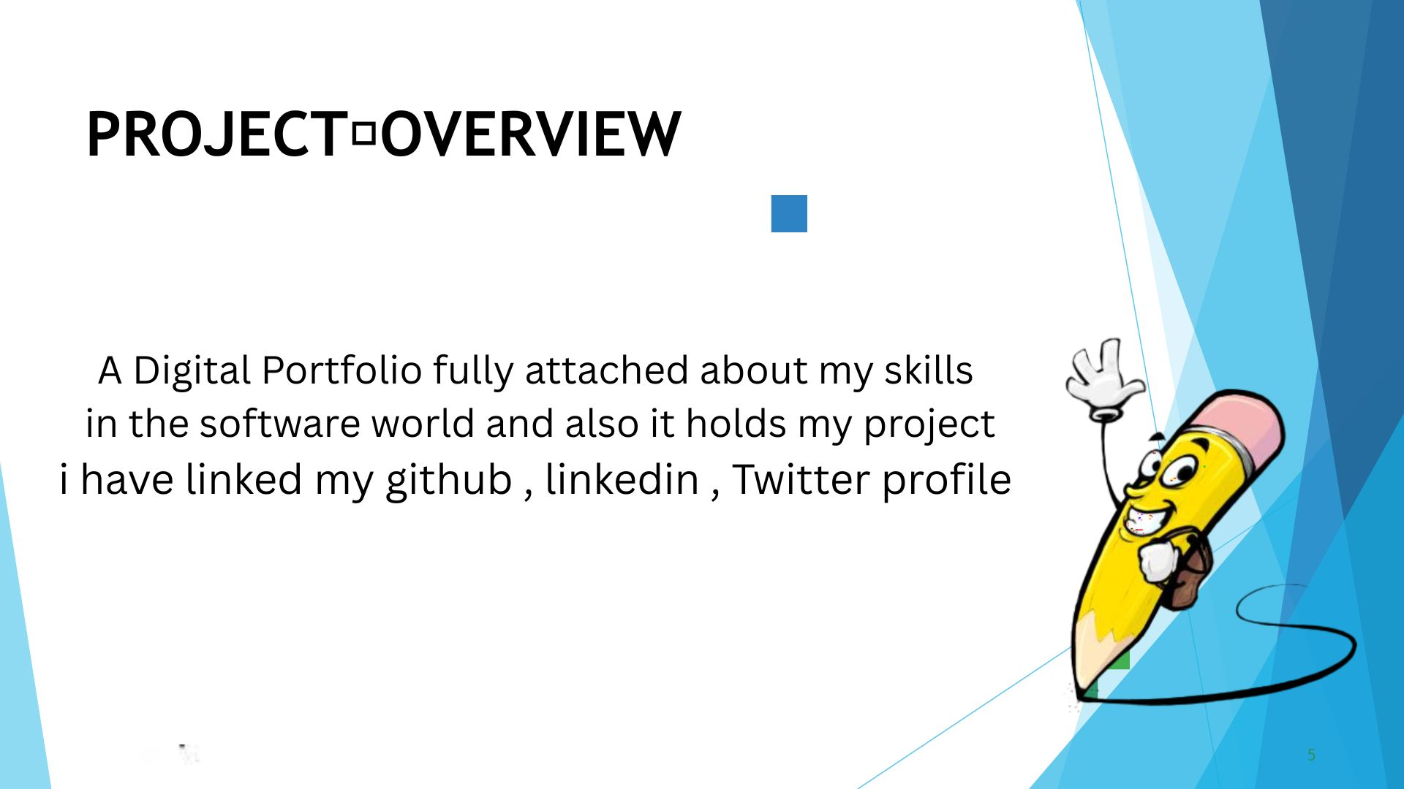

PROJECT OVERVIEW

Slide 6
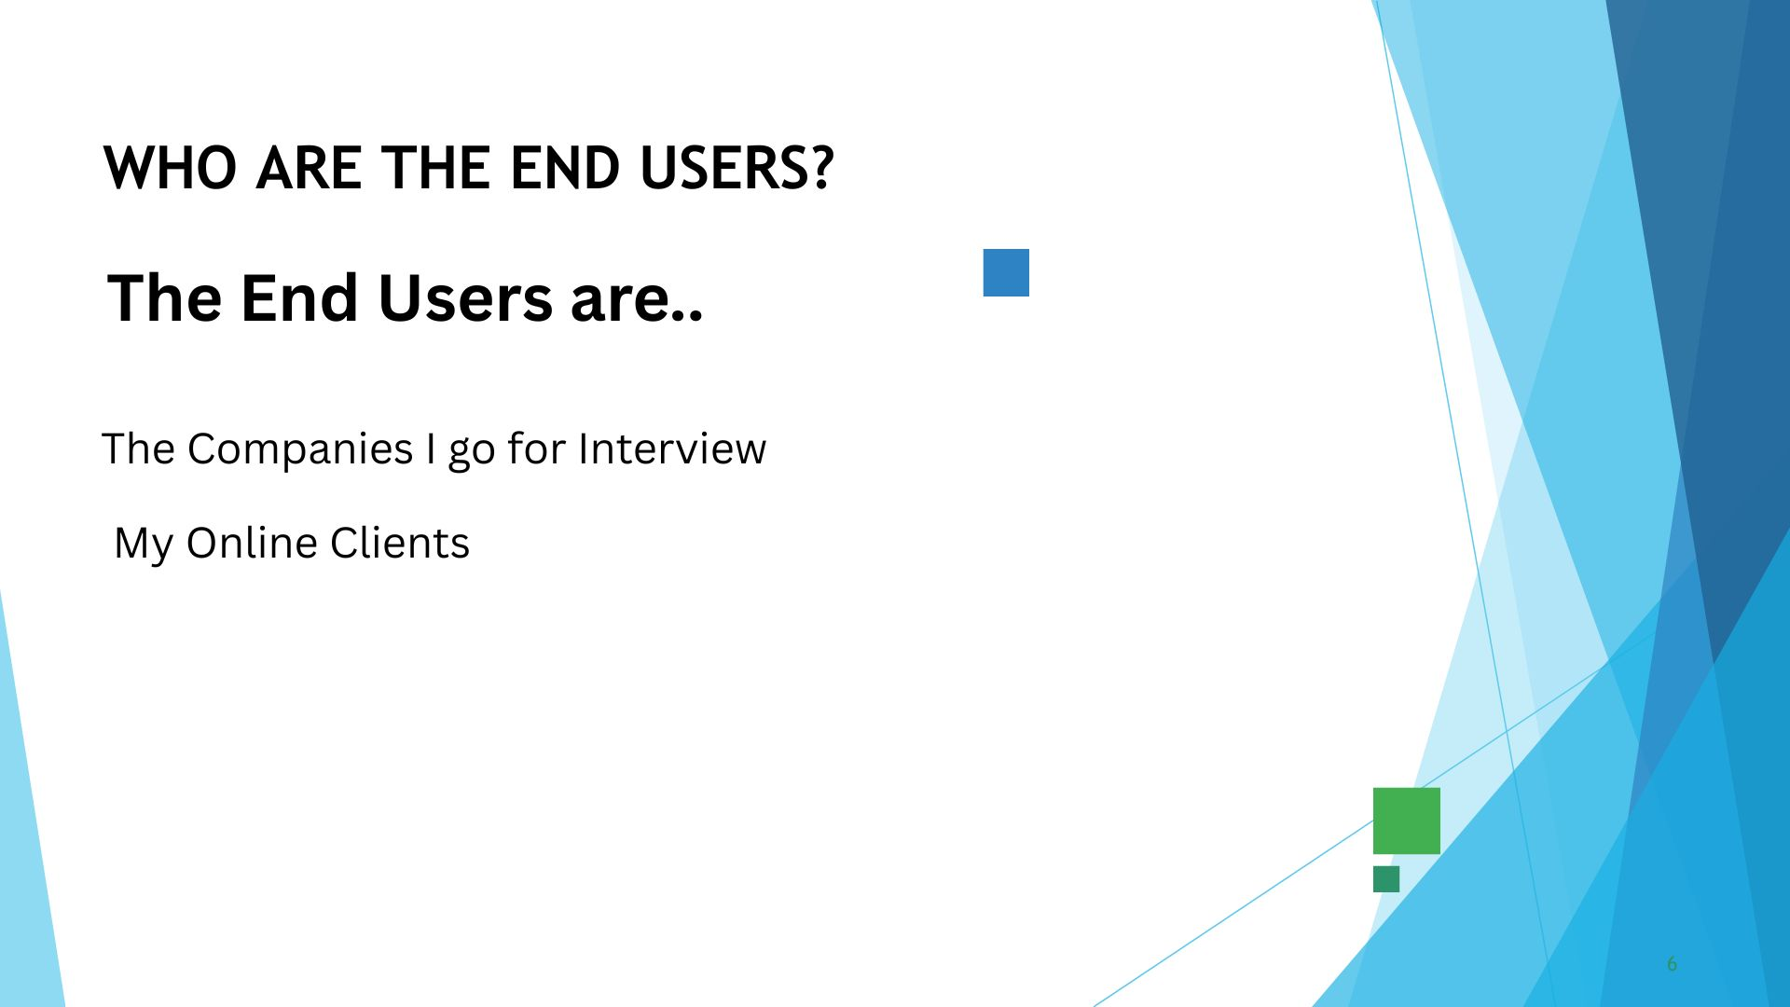

WHO ARE THE END USERS?

Slide 7

TOOLS AND TECHNIQUES HTML CSS JAVA SCRIPT

Slide 8
POTFOLIO DESIGN AND LAYOUT
It has a maginificent Purple blended violet colors and it has my profile photo , My name in the Starting
after scrolling down you can find my projects , and what Skills do i have and lastly you got a information box
to fill up your details and get in touch with me...
- Thank you!!
8

Slide 9
FEATURES AND FUNCTIONALITY Displays My Essential Details Scrolls Smootly it has a Arrow button in the left to scroll up from down

Slide 10
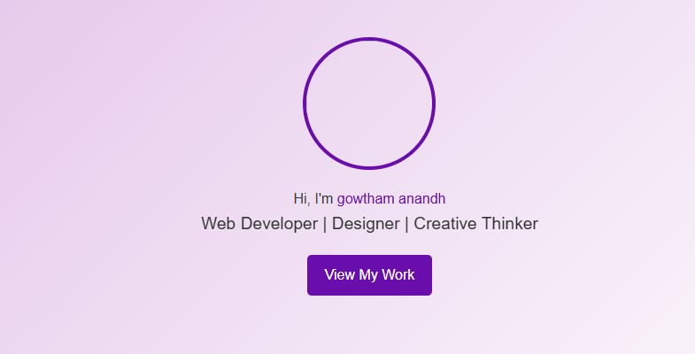
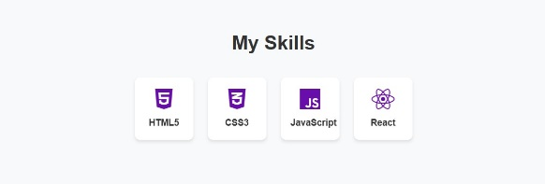
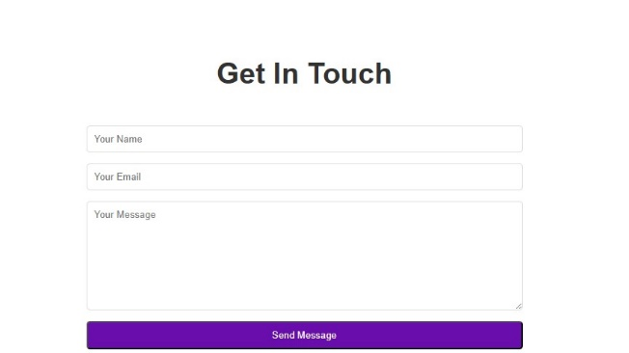

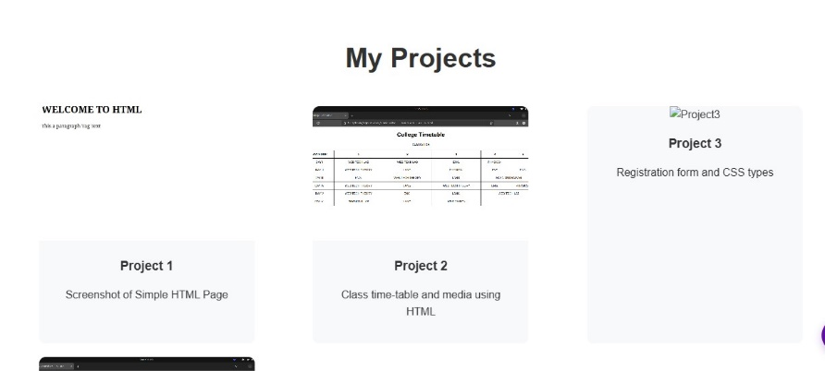
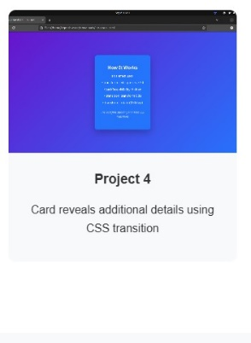
RESULTS AND SCREENSHOTS
3/21/2024 Annual Review
10

Slide 11
CONCLUSION I have created this Portfolio with my Hardwork and consistency
GIT HUB LINK: https://github.com/24j009-gowtham/TNSDC-FWD-portfolio.git
PORTFOLIO: https://24j009-gowtham.github.io/TNSDC-FWD-portfolio/
11

